Slide 1

Tutur.

Slide 2
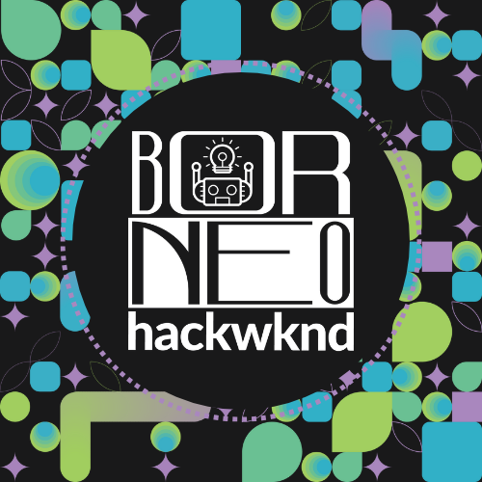
AI-POWERED LANGUAGE LEARNING FOR INDIGENOUS ASEAN LANGUAGES
Tutur.

Slide 3
THE PROBLEM
170+
93%
1,200+
AT RISK
FEWER RESOURCES
LANGUAGES
Languages Facing Extinction (UNESCO)
Spoken Across ASEAN
Spoken Across ASEAN
The digital age is accelerating language death, not preventing it.

Slide 4
OUR SOLUTION
AI-POWERED & GAMIFIED
Interactive learning platform built specifically for underrepresented ASEAN languages
TARGET LANGUAGES
Minangkabau, Batak Toba, Iban, Sarawak Malay
ALIGNED WITH SDGS
SDG 4 — Quality Education | SDG 10 Reduced Inequalities | SDG 11 Sustainable Cities and Communities

Slide 5
L
I
V
E
D
E
M
O

Slide 7
KEY FEATURES
NLP ENGINE
LOCALIZED PRICING
Custom models for 5 low-resource ASEAN languages
Payment integration 60–80% cheaper vs global apps
CULTURAL MODULES
PWA TECHNOLOGY
Folktales, folk songs, oral literature as learning content
No app store needed, works on any device
MULTIMODAL LEARNING
CULTURAL AUTHENTICITY
Text Q&A, audio listening, comprehension exercises
Community-reviewed content preserving linguistic integrity

Slide 8
IMPACT & FUTURE
FUTURE
TODAY
Functional prototype with NLP + cultural content
Native speaker community hub
Offline / low-bandwidth mode for rural communities
Language certification system
Expansion to Kadazan-Dusun & Orang Ulu dialects
AI voice synthesis with regional accents
What's Next for Tutur ?

Slide 9


PRESERVING VOICES, ONE LANGUAGE AT A TIME
"When a language dies, humanity loses a perspective that can never be recovered."
https://tutur-app.my.id/
THANK YOU

